Slide 1


Please write title, subtitle and speaker name in all capital letters
Operating Elasticsearch in Kubernetes
MIKKEL LARSEN @mikkeloscar
OLIVER TROSIEN
@otrosien
2019-04-02

Slide 2

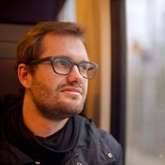
WHO ARE WE?

Slide 3
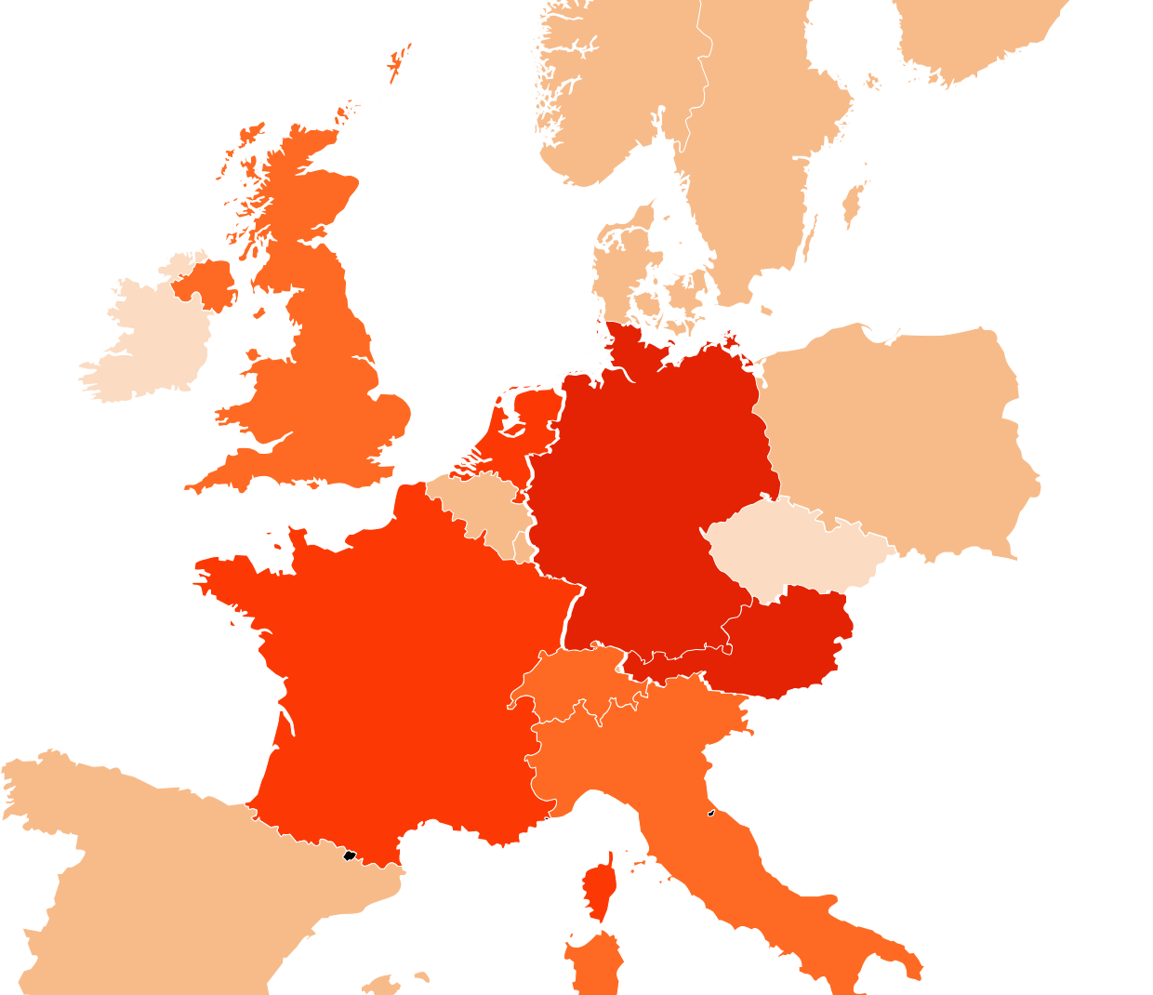
WE BRING FASHION TO PEOPLE IN 17 COUNTRIES
17 markets
7 fulfillment centers
26 million active customers
5.4 billion € revenue 2018
250 million visits per month
15,000 employees in Europe
Notes:
2008/2009: Germany, Austria
2010: Netherlands, France
2011: Italy, UK, Switzerland
2012/2013: Sweden, Belgium, Spain, Denmark, Finland, Poland, Norway, Luxembourg
2018: Czech Republic, Ireland

Slide 4
ZALANDO AT A GLANCE
Please write the title in all capital letters
Use bullet points to summarize information rather than writing long paragraphs in the text box
~ 5.4billion EUR
revenue 2018
> 250
million
visits
per
month
> 300.000
product choices
> 26
million
active customers
> 15.000
employees in
Europe
> 79%
of visits via mobile devices
~ 2.000
brands
17
countries
Notes:
We are Europe's leading Online Fashion platform

Slide 5

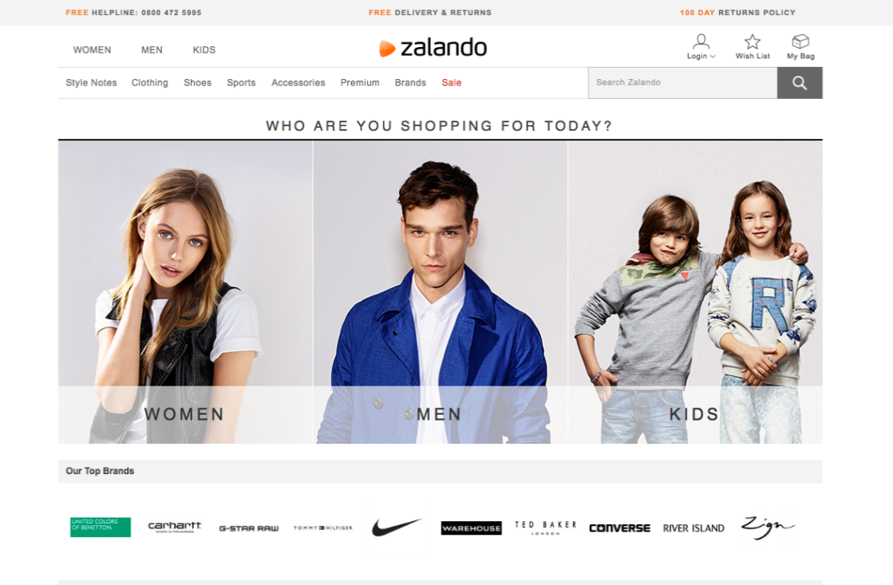
ZALANDO TECH
Please write the title in all capital letters
Use bullet points to summarize information rather than writing long paragraphs in the text box
~ 2.000
Employees in Tech
~ 300
Delivery teams
Notes:
We are around 2.000 employees in tech and more than 200 tech teams.

Slide 6


SEARCH @ ZALANDO
45% Mobile Traffic
300k+ Products
per country
~2000
Brands
12K QPS
~700
Categories
8K
Updates/s
Notes:
The Search Department
Don’t repeat numbers
Active customers
Other interesting metrics
Department size (headcount)

Slide 7


DATA INGESTION
Stock availability
Fashion Tags
Scoring
Article Content
Elasticsearch
Pricing & Campaigns
Image Tags
Color Enrichment
Kafka / Nakadi *
* nakadi.io
Notes:
Nakadi Logo (see nakadi.io)
Massive denormalisation -> high update rate

Slide 8
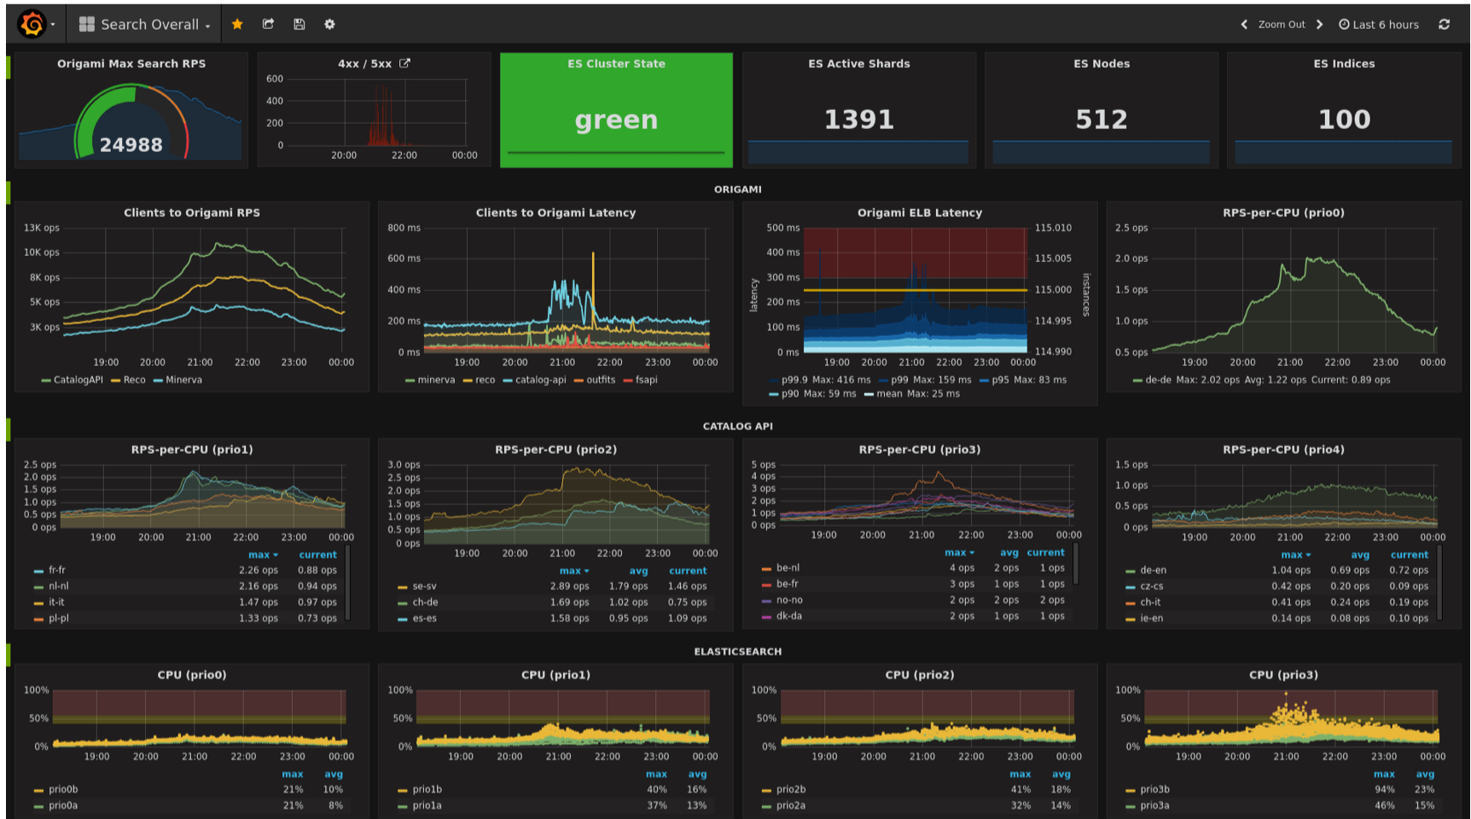
Notes:
No matter how

Slide 9



KUBERNETES @ ZALANDO
Please write the title in all capital letters
Use bullet points to summarize information rather than writing long paragraphs in the text box
112
clusters
Default Deployment Target
1.3k
nodes
Node Autoscaling
Since 2016
From v1.4 to v1.12

Slide 10









KUBERNETES CLUSTER SETUP
Master
Master
Config
EC2
Instances
CloudFormation Stacks
Worker
github.com/zalando-incubator/kubernetes-on-aws
Notes:
Some infrastructure details. How is a cluster setup?
So our clusters are in an AWS account;
We have 3 cloudformation stacks, one for each component in the left;
All nodes are EC2 instances;
We run CoreOS in all nodes;
We use a separated config for etcd, and Docker for containers.

Slide 11





CLUSTER PROVISIONING
CLUSTER LIFECYCLE MANAGER (CLM)
apply manifests
CloudFormation
CLUSTER
REGISTRY
CLM
API
...
provision
resources
...
API
...
github.com/zalando-incubator/cluster-lifecycle-manager
github.com/zalando-incubator/kubernetes-on-aws
Notes:
Reduce not so relevant information

Slide 12
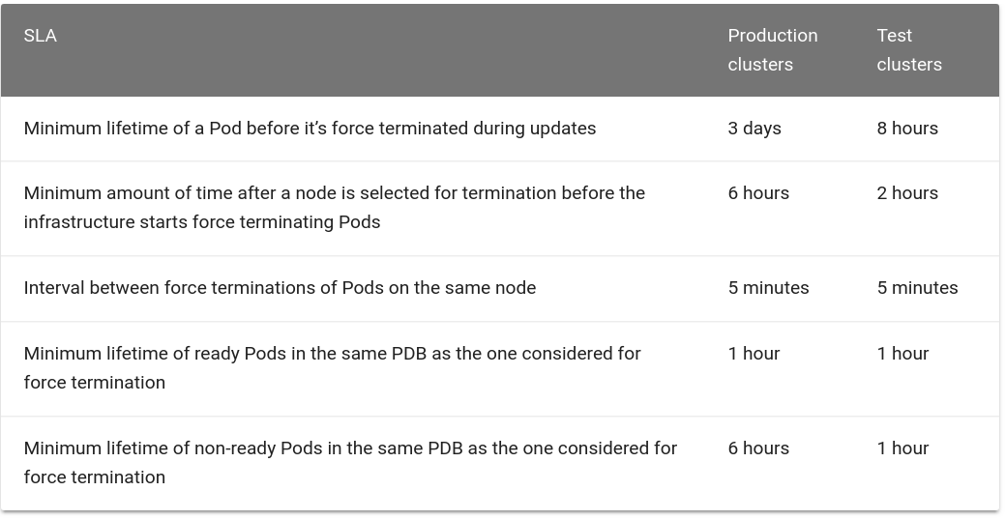
CLUSTER UPDATE POLICY (SLA)
github.com/zalando-incubator/cluster-lifecycle-manager
github.com/zalando-incubator/kubernetes-on-aws
Notes:
Reduce not so relevant information

Slide 13


Elasticsearch 2.500 vCPUs
1 TB RAM
Project “ES Operator”

Slide 14

ES Operator
Put images in the grey dotted box "unsupported placeholder" - behind the orange box (left side stays white)
Write the quote in all capital letters
Notes:
We need our own operator
Decision basic featureset
Rolling updates
Advanced Autoscaling

Slide 15
UPDATING ELASTICSEARCH (STATEFULSET)
Please write the title in all capital letters
Use bullet points to summarize information rather than writing long paragraphs in the text box
1) PreStop Hook (bash script)
Exclude node in ES
Wait for node to drain (up to 1h)
Data is moved to existing nodes
Node
Node
ES Pod
ES Pod
ready
ready
Node
Node
ES Pod
ES Pod
ES Pod
2) PostStart Hook (bash script)
Remove all excludes
Let ES rebalance from existing nodes
ES Pod
terminating
ready
ready
draining
Notes:
Operator sets Pod Disruption Budget 0
TerminationGracePeriodSeconds: 3600 (1h) https://github.com/helm/charts/blob/9bf7799e7f91d2e1142be8d6724c8aa9cc7ed8a9/incubator/elasticsearch/values.yaml#L101
Hooks are “bound-to-succeed”
Visualize data moving.

Slide 16
ELASTICSEARCH DATA SETS
Please write the title in all capital letters
Use bullet points to summarize information rather than writing long paragraphs in the text box
apiVersion: zalando.org/v1 kind: ElasticsearchDataSet metadata: name: test-cluster spec: scaling:
{...}
replicas: 3 template: # PodTemplate {...} volumeClaimTemplates:
{...}
github.com/zalando-incubator/es-operator
Notes:
We do not try to abstract podTemplates or volumeClaimTemplates
Scaling will be explained later

Slide 17
ELASTICSEARCH DATA SETS
Please write the title in all capital letters
Use bullet points to summarize information rather than writing long paragraphs in the text box
ES
Operator
ES Data
ES Data
ES Data
ES Data
ES Data
ES Master
ES Data
ES Data
ES Master
ES Data
ES Data
ES Master
github.com/zalando-incubator/es-operator
Notes:
We do not try to abstract podTemplates or volumeClaimTemplates
Scaling will be explained later
ES Node ^= Pod

Slide 18
UPDATING ELASTICSEARCH (OPERATOR)
Please write the title in all capital letters
Use bullet points to summarize information rather than writing long paragraphs in the text box
Node
Node
ES Pod
ES Pod
ready
ready
ES Service
1) Scale out by 1
2) Drain node
draining
Node
Node
ES Pod
ES Pod
ES Pod
ES Pod
ES
Operator
3) Delete Pod
ready
ready
draining
github.com/zalando-incubator/es-operator
Notes:
Operator sets Pod Disruption Budget 0

Slide 19
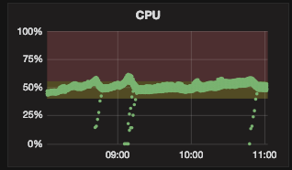
SCALING UP ELASTICSEARCH (1)
Please write the title in all capital letters
Use bullet points to summarize information rather than writing long paragraphs in the text box
METRICS
Thresholds
CPU
Duration
Cooldown
Boundaries
Max # Pod replicas
Node
ES Pod
2 shards
Node
Node
ES Pod
Node
2 shards
ES Pod
Node
ES Pod
2 shards
3 shards
ES Pod
Node
Node
2 shards
ES Pod
6 shards
Node
ES Pod
Node
ES Pod
2 shards
ES Pod
3 shards
Node
2 shards
ES Pod
Node
2 shards
ready
ES Pod
2 shards
ready
Node
ES Pod
ready
ready
1 shard
ready
ready
ready
ready
ready
ready
ready
ready
Increase pod replicas
Notes:
Scaling Parameters
Node replicas
Index replicas
CPU graph
Hands-off when cluster is not green
Not HPA

Slide 20
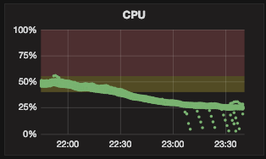
SCALING DOWN ELASTICSEARCH
Please write the title in all capital letters
Use bullet points to summarize information rather than writing long paragraphs in the text box
DON’T OPERATE WHEN CLUSTER IS NOT GREEN!
METRICS
Thresholds
CPU
Duration
Cooldown
Boundaries
Min # Replica
Max # Shards per node
Max disk usage (%)
Node
Node
ES Pod
2 shards
Node
Node
ES Pod
Node
2 shards
ES Pod
ES Pod
6 shards
2 shards
ES Pod
Node
Node
3 shards
ES Pod
Node
ES Pod
2 shards
2 shards
ES Pod
Node
Node
3 shards
ES Pod
2 shards
ES Pod
Node
2 shards
ready
ES Pod
2 shards
ready
ready
Node
ready
ready
ES Pod
1 shard
ready
ready
ready
ready
ready
ready
ready
Decrease Pod replicas
Notes:
Scaling Parameters
Node replicas
Index replicas
CPU graph
Hands-off when cluster is not green

Slide 21
SCALING UP ELASTICSEARCH (2)
Please write the title in all capital letters
Use bullet points to summarize information rather than writing long paragraphs in the text box
METRICS
Thresholds
CPU
Duration
Cooldown
Boundaries
Min # Shards per node
Node
ES Pod
2 shards
Node
Node
ES Pod
Node
2 shards
ES Pod
Node
ES Pod
2 shards
3 shards
ES Pod
Node
Node
2 shards
ES Pod
1 shard
Node
ES Pod
Node
ES Pod
2 shards
ES Pod
1 shard
Node
2 shards
ES Pod
Node
1 shard
ready
ES Pod
2 shards
ready
Node
ES Pod
ready
ready
1 shard
ready
ready
ready
ready
ready
ready
ready
ready
Increase index replicas
Notes:
Scaling Parameters
Node replicas
Index replicas
CPU graph
Hands-off when cluster is not green

Slide 22

DEMO
Please write the title in all capital letters
Use bullet points to summarize information rather than writing long paragraphs in the text box

Slide 23
OPEN SOURCE
Please write the title in all capital letters
Use bullet points to summarize information rather than writing long paragraphs in the text box
ES Operator
github.com/zalando-incubator/es-operator
Cluster Lifecycle Manager
github.com/zalando-incubator/cluster-lifecycle-manager
Kubernetes on AWS
github.com/zalando-incubator/kubernetes-on-aws
microXchg demo
github.com/otrosien/microxchg19-demo

Slide 24
Please write contact name, department and position in all capital letters
MIKKEL LARSEN
mikkel.larsen@zalando.de
@mikkeloscar
OLIVER TROSIEN
oliver.trosien@zalando.de
@otrosien
2019-04-02

